Slide 1

AWS SAA RELATIONAL DATABASE SERVICE
BY
Lilian SHULIKA TATA(WIRFON CLOUD)

Slide 2
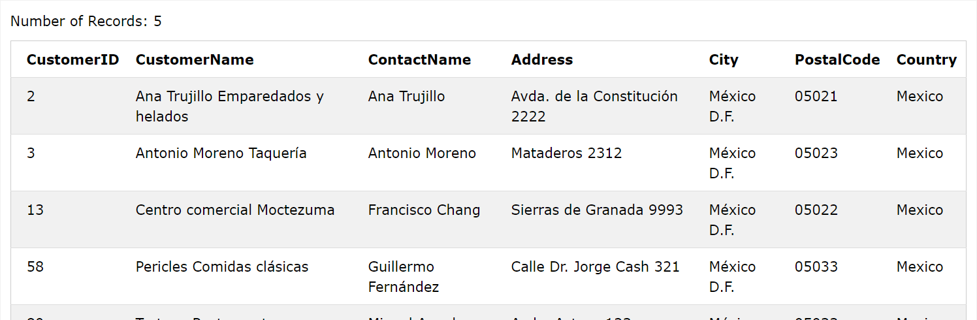

DATABASE REFRESHER A system which stores and manages data(Relational(SQL) and Non Relational Database(NoSQL))

Slide 3

Relational Database (SQL)
Definition
Features
SQL(wrong, why…?) / RDBMS
SQL – accessing, updating and manipulating data in a database
MySQL(RDBMS) – Keeping data that already exists in a database organized(Management software).
A table-based data structure, with a strict, predefined schema required which are related
MySQL, PostgreSQL, SQLite, MariaDB, Oracle, SQL Server
Structured; in and between DB tables(attributes and attribute values)
Rigid Schema; defined in advance before you put any data in it, Names, valid values and types of data and where its stored
Fixed relationship between tables
No Flexibility
https://www.w3schools.com/sql/trysql.asp?filename=trysql_select_where

Slide 4
Non –Relational Database(NOSQL)
Unstructured data base (Not tabulated)
Very Flexible/relaxed schema (Can add information as required)
Relations between tables are handles differently(High level for EXAM)
Scalable
Really fast
Only the Key matters, you write and read values from keys
Key Value stores are used In Memory Caching

Slide 5

Types of Non relational DB (NoSQL)
Key Value Databases
e.g A storage facility
- Unstructured, Just a list of Unique Key and Value(Content)
Wide Column Store
It has One or more keys unique to that table.
a partition key and/or composite key(same key structure)
Have attributes but don’t have to be the same as in RDB
e.g: Getting information from multiple EC2 instances/DynamoDB

Slide 6
Types of Non relational DB NoSQL cont.
Document store
Column Databases
Designed to store and query data as Documents / JSON/XML
Structure can be different between documents in a database
Extension of Key Value store with a unique ID to the Document
Interacting with whole documents or deep attributes(nested documents e.g. catalogues, user profiles)
Flexible indexing (Can run powerful queries)
Graph style DB
Great for relationship data(Facebooks)
Relationships are formally defined and saved in the data
Relationships between nodes and edges
Row Store(MySQL)
Interacting with data on rows, adding, updating, deleting
Online Transaction Processing. OLTP-Order DBs, stock DBs,
Rows and items that are constantly modified
Column Store (Redshift)
Same as row but stored in columns with same item information
Makes it very inefficient for transaction style reporting but makes it good for reporting as you can query all products or variants for an item

Slide 7

ACID VS BASE
Transaction models - ACID
CAP Theorem- Consistency, Availability and Partition Tolerant(resilience) – “Any DB problem is only capable of delivering a max of 2 of these factors”.
Consistency(ACID)- every read to a DB will receive the most recent write or an error.
Availability(BASE) – Every request will receive a non error response but without the guarantee that it will receive the most recent write
Partition tolerance- the system is made of multiple network partitions and continues to operate despite the number of dropped messages or errors

Slide 8
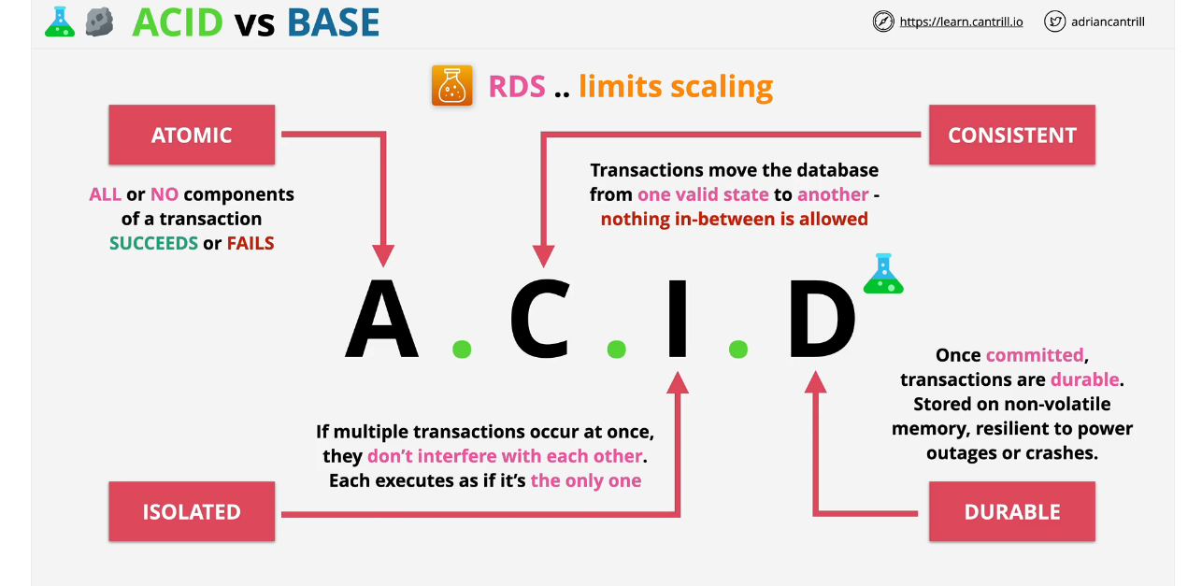
ACID

Slide 9
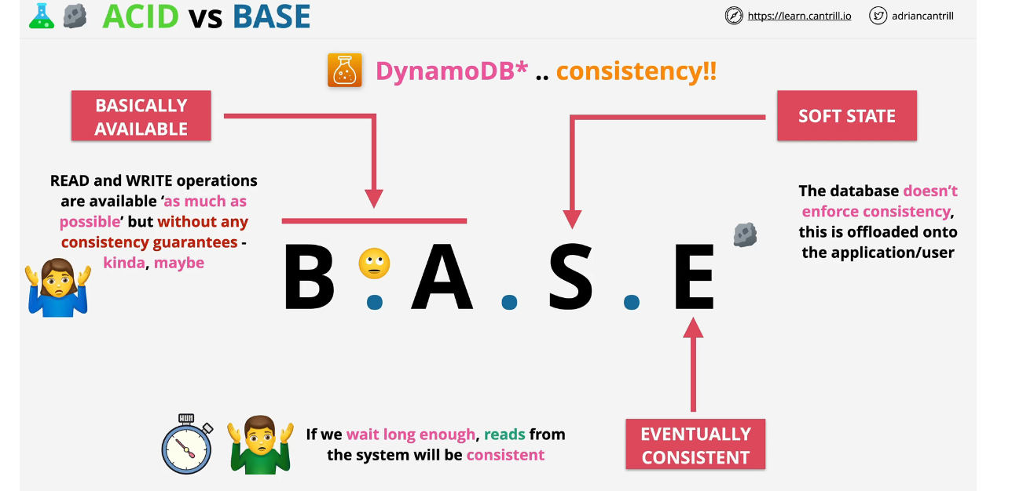
BASE

Slide 10

EXAMS
Base Management – NOSQL
ACID – RDS DB
ACID + DynamoDB=DynamoDB transactions

Slide 11

DATABASES ON EC2
Why you might need it
Access to the DB instance OS
Advanced DB Option tuning(DBROOT), Vendor demands
DB or DB versions AWS don’t provide
Specific OS/DB combination AWS don’t provide
Architecture AWS don’t provide (replication/resilience)
Decision makers just want it

Slide 12

Why you don’t need DB on EC2
Admin overhead – managing EC2 and DBhost
Backup / DR recovery management
EC2 runs on a single AZ(EBS volume, you manage EBS snapshots etc)
Features – some of AWS DB products are customized to suit needs
EC2 is On or Off – no serverless, no easy scaling
Replication – skills, setup time, monitoring and effectiveness
Performance – Aws invests time into optimization and features

Slide 13
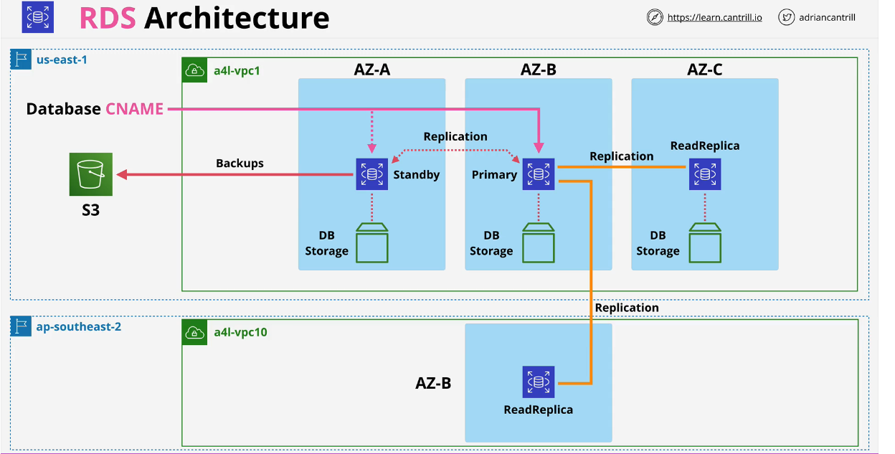

Slide 14
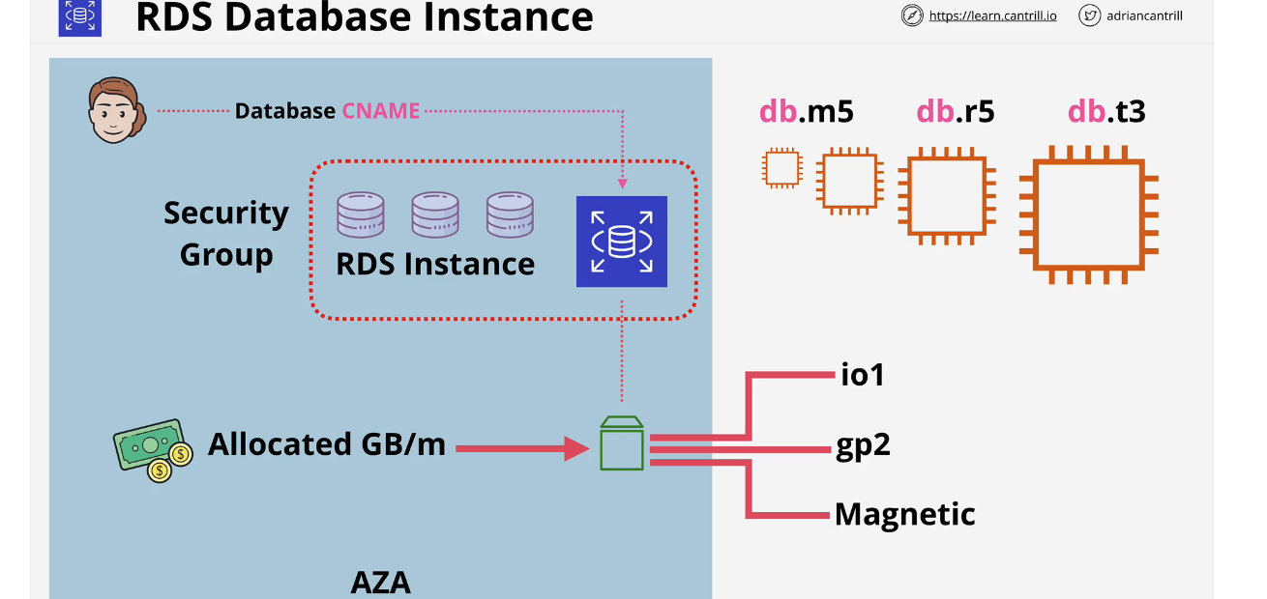
General Purpose
Memory optimized
Burstable perfomance instance
Accessed using CNAME, only means of access
DB instance classes (det. Computation and mem. capacity)
An instance runs one of the few types of DBs engines and can contain multiple user created DBs
SSD storage, high end performance, lots of IOPS, consistent low latency
RDS DB Instances
Can be single Az or Multi AZ(Failover)
Billed for instance used and storage allocated, GB/m
Extra pa for IOPS added
Recommended as default, same EC2 performance profile
- allocate storage (Failover)
EBS attached in the same zone(Vulnerable to failure coz of 1 AZ)
Offered by AWS For long term

Slide 15
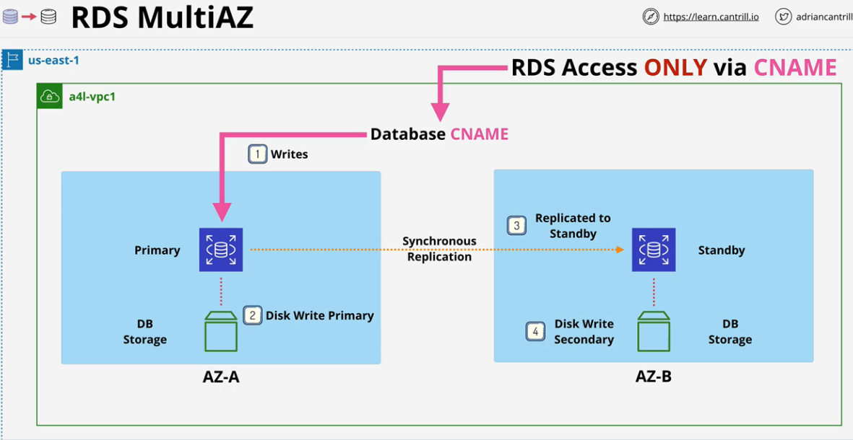

Can enable multi AZ on RDS instances, secondary hardware is allocated in another AZ as standby replica
you cant access Standby replica using RDS
RDS multi AZ provides high availability not fault tolerance (why?)
-Failover with Brief interruption, 60-120sec
If error occurs with primary instance, RDS detects this and changes DB and CNAME moving it from the Primary instance to the standby replica
Replication happens at the same time as data as written to the primary and standby instances creating almost zero lag

Slide 16

EXAM POWERUPS Can RDS multi AZ be used to scale the number of reads an RDS support?
Multi AZ is not available for free tier, cost 2x the price- extra cost for standby replica
Standby replica cannot be accessed directly, all access is via a single DB CNAME.
Standby can only be accessed during a failover, has no performance benefits
Its an availability improvement not a performance one.
Multi AZ is in the same region only(other AZs in the VPC)

Slide 17

EXAM POWERUPS
AZ Outage, Primary Failure, Manual Failover, Instacne type change, Software Patching
Failover is between 60-120secs(Highly available not Fault tolerant)
MultiAz offers some non availability improvements e.g RDS backups are taken from standby replica
Have no performance impacts and no disruption on primary DB
Different with One AZ.. (why?)
Synchronous Replication - Multi AZ – sameregion
Standby replica cant be used to read, scale or write, only for failover

Slide 18
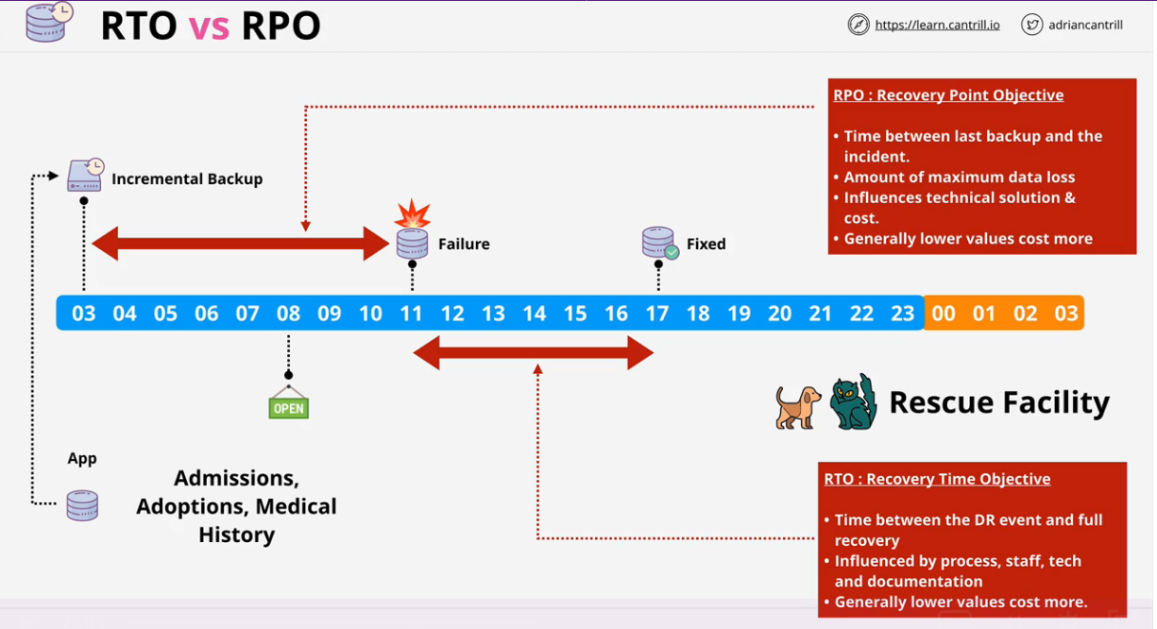
RDS AUTO BACKUPS,SNAPSHOTS AND RESTORES RDS BACKUPS Recovery Time Objective (RTO) VS Recovery Point Objective (RPO)
Lowering RPO increases chances of recovery,eg 2 sec vs 8hr. But increases costs
- Sourcing and reinstalling new hardware, finding staff to do that and actually restoring the DB
- Can be reduced by having spare hardware or effective resources, as well as
- system for easy restore

Slide 19
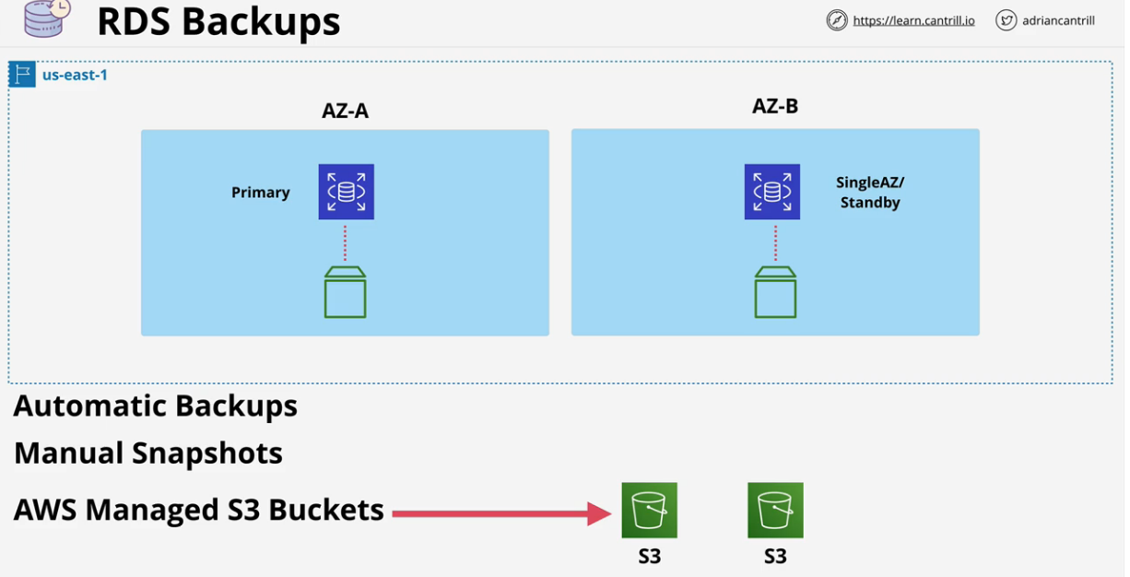
Types
-Data backed up Is region resilient
-Replicate's data across multi AZ
-Backups Occur from single DB instance with MultiAZ disabled or standby if Multi AZ is enabled.
Primary instance is never used

Slide 20
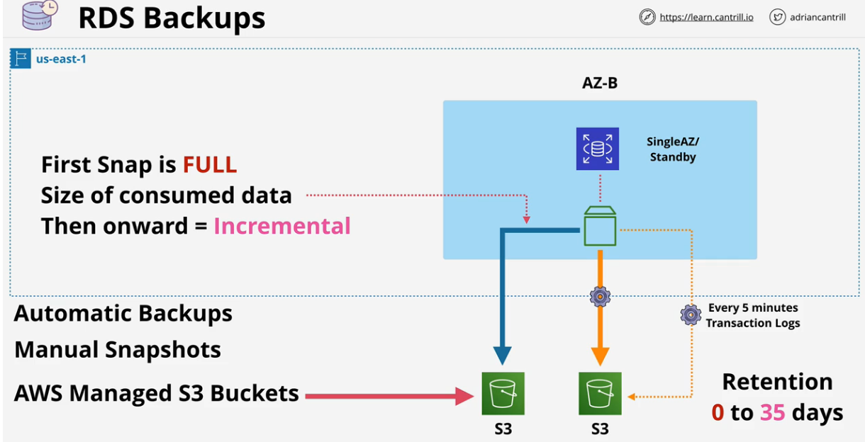
SNAPSHOTS Disastery recovery/Business Continuity
Snapshots- full copy of data used in RDS instance
Only store change in data
They don’t expire, you have to clear them, live past the life time of RDS instance
Written to S3, transaction data stores the actual data that changes within the DB(5min RPO)

Slide 21
EXAM POWERUPS
Deleting an RDS instance doesn’t delete a manual snapshot, you have to delete it yourself
Snapshots are taken of the DB instance storage, thus contain all DB in the Instance
Every restore – new RDS instance – new address(updates to use new endpoint address)
Automated = 5 mins point to restore DB
Backups are restored from the transaction logs and “replayed” to bring DB to desired point in time
Restores aren’t fast – think about RTO

Slide 22
Read Replicas - Asynchronous replication (written fully to primary instance - stored on disc - replicated to read plicas) - Cross region read replica (written to other regions) - Fully encrypted - Why do RR Matter?
2. Availability improvements
Snapshots and backups improve RPO(offer near 0 RPO)
RTO is still a problem
If primary DB fails, RR can be promoted to be a primary DB instance – low RTO
Failure only – watch for corrupt data
Reads only until Promoted
Global Availability improvements- Global resilience(RR can be promoted)
. 1. Performance improvement
scale out read capacity for a DB)
RR can have RR within them but will lag
Global performance improvements
Can't be written on

Slide 23

Amazon RDS Security Authentication, Authorization, Encryption (Transit / Rest)
Encryption in Transit- SSL/TLS-available for RDS- can be mandatory
Encrypted by Host/EBS the RDS instance is running on
Supports EBS volume Encryption – KMS
Can use AWS or Customer managed CMK to geberate data keys
Data keys used for encryption operations

Slide 24
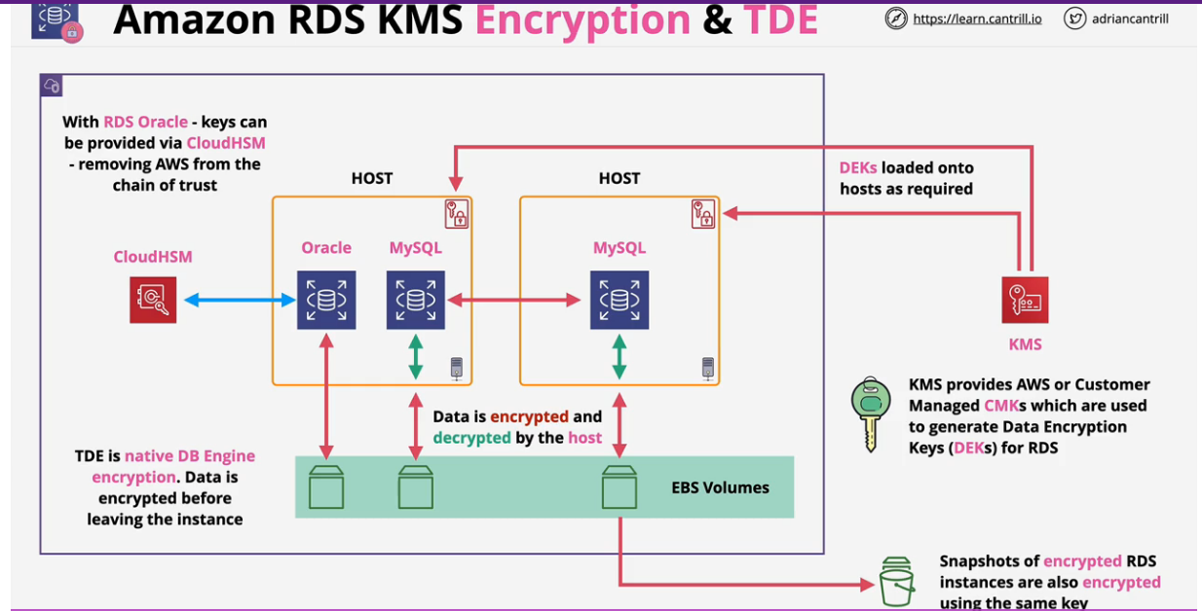
RDS MSSQL and RDS Oracle support TDE(Transparent data encrytion) Here, encryption is handled within the DB engine RDS oracle supports integration with CloudHSM

Slide 25

Aurora Architecture
Very Different from RDS
Uses a “cluster”- made up of single primary instance + 0 or more replicas
Doesn’t use local storage, uses a shared cluster(Volume cluster)
Fater provisioning, improved availability and performance
Automantically detects failures and repairs areas where disc failed
Corrects corrupte data/disc
Its storage is much more resilient
Can have upto 15 replica’s to choose to failover to

Slide 26
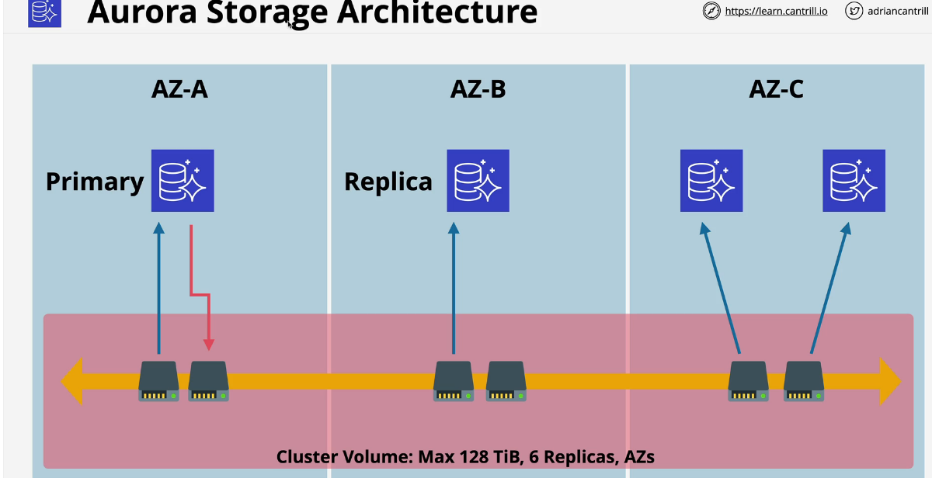











Slide 27

Aurora storage Architecture
All SSD Based – High IOPS, Low Latency
Storage is billed based on Whats used
High water marked, Billed for most used(If you use 50gb and free 10 later, you still billed for 50 GB)…will be updated by AWS
Storage freed up can be reused, to reduce cost, create new cluster and migrate DB, then create new cluster
Replicas can be added and removed without requiring storage provisioning

Slide 28
Aurora Endpoints(DNS addresses used to connect to the cluster)
Cluster Endpoints
Reader Endpoints
Points to the Primary instance
Used for read and write operations
Points to Primary if theres only 1 instance
Load Balances across replica’s if there are any replicas
Makes it easier to manage read scaling with Aurora than RDS

Slide 29

Aurora Costs
No free tier for Aurora (Doesn’t support micro instances in free tier)
Beyond RDS single AZ(micro), aurora offers better value
Compute – Hourly charge, billed per second, 10 mins minimum
Storage- GB/month consumed, IO cost per request
100% DB size in free backups included for the cluster
Backups are same as RDS / Restores create new cluster
Backtrack can be used to roll back DB to a previous point in time
Fast clones make new DB faster than copying all data (copy – on write)

Slide 30

Aurora Serverless
Aurora serverless is to Aurora what Fargate is to ECS
Removes Admin overhead/ no provisioning of resources
Scalable – ACU- Aurora Capacity Units
Has min/max ACU – based on load – can go to 0 and be paused
Billing based on per second basis
Same resilience as Aurora provisioned(6 copies across AZs)
Easier to scale

Slide 31
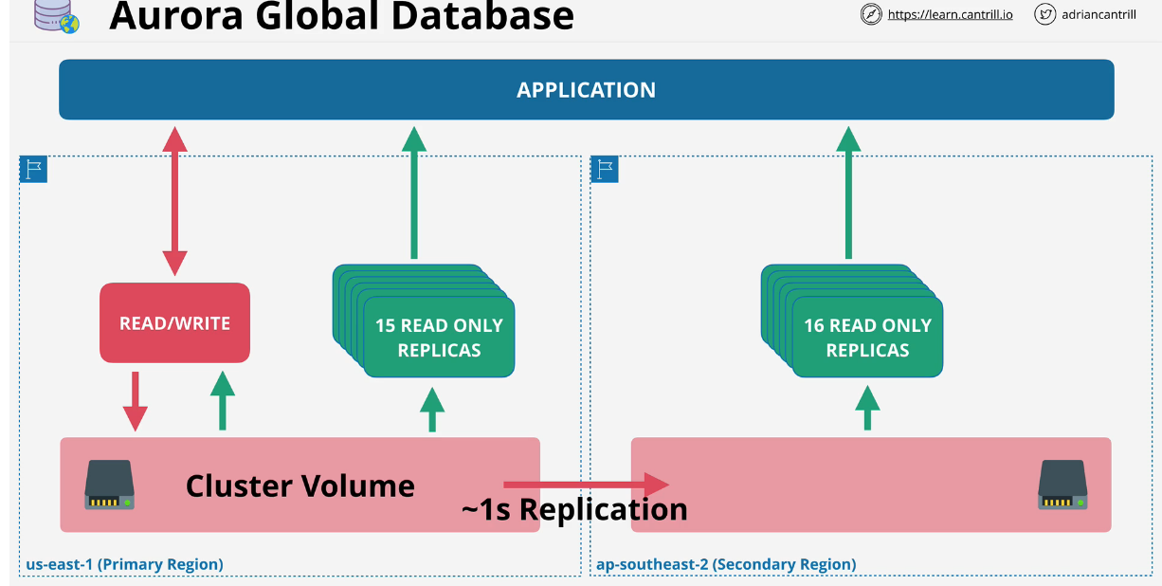

Slide 32

Aurora Serverless Use Cases
Infrequently used applications
New applications (Unsure of levels of load)- Auto scale
Variable workloads/unpredictable workloads (certain period/time)
Development and test Databases
Multi-tenant applications where scaling is fairly aligned
Great for Global Read scaling- Low latency performance improvements
1s or less replication between regions/ no impact on DB performance

Slide 33

Aurora Global Database
Allow you to create global level replication using Aurora from a master region
Upto 5 Azs as secondary regions max
Secondary regions could have upto 16 replicas
Can be promoted to Reas and Write
Great for Cross –region Disaster Recovery and Business Continuity

Slide 34
Aurora Multi Master
Multiple instances performing reads and writes unlike RDS
Equates to one read/write cluster and 0+ read Only replicas
Cluster endpoint used to write, read endpoint is used for load balancing reads
Fail over takes time- to happen, replica promoted to R/W mode
In Multi master mode, all instances are R/W

Slide 35
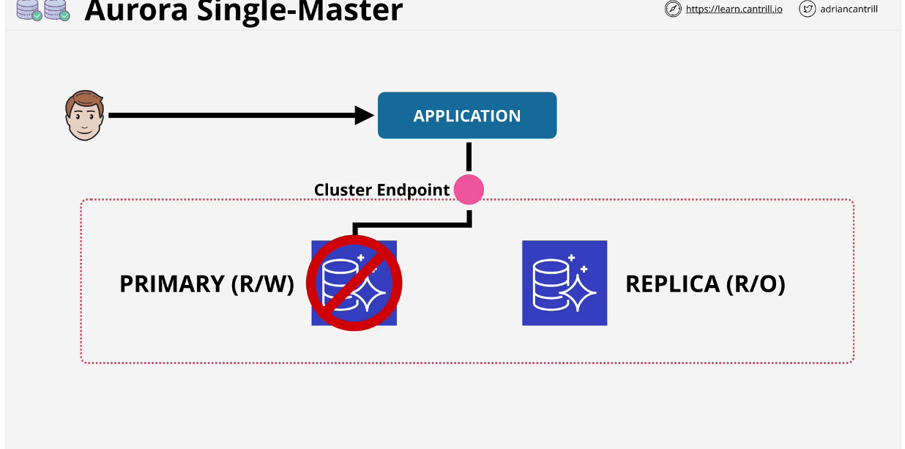
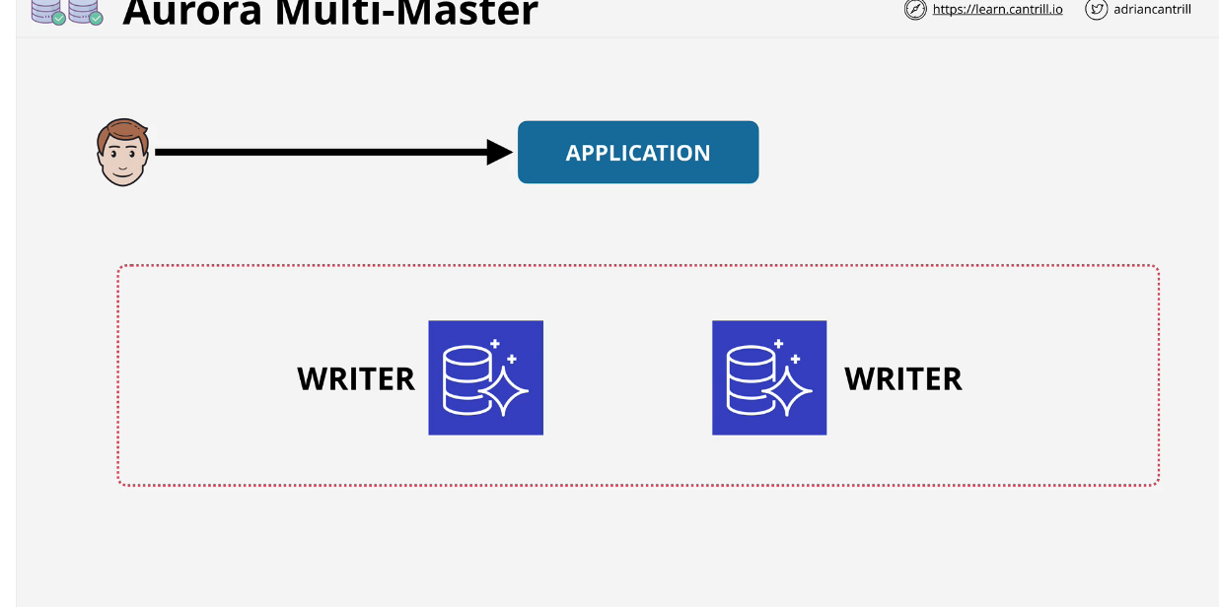
ASM vs AMM

Slide 36
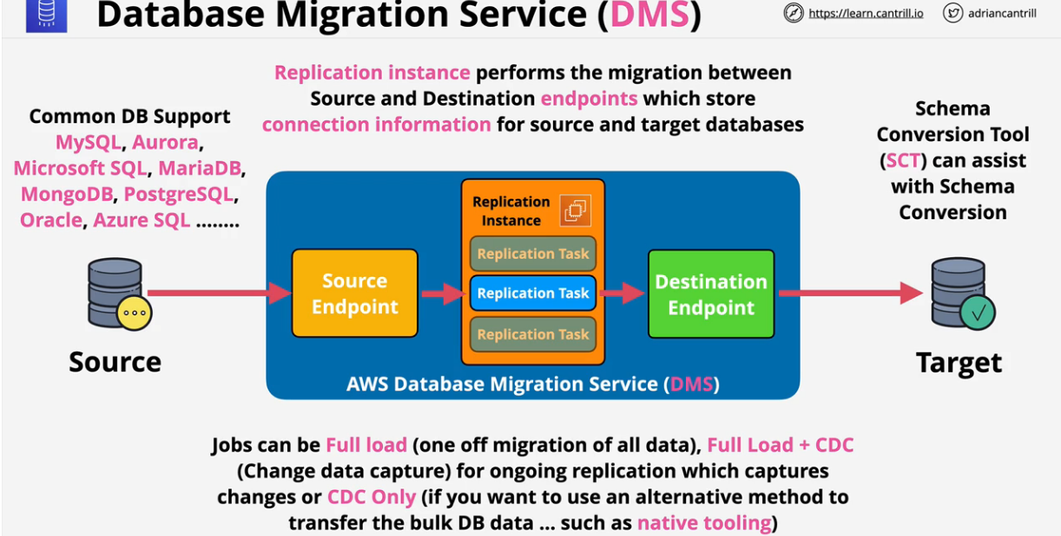

Slide 37
Database Migration Service
A Managed DB migration service
Runs using a replication instance
Source and destination endpoints
Sources and target DB
One endpoint must be on AWS
EXAMS
SCT = DMS
No downtime + DMS
One of the source or target on AWS = DMS

Slide 38
Question
QUESTION 1
A solutions architect is designing a new service behind Amazon API Gateway.
The request patterns for the service will be unpredictable and can change suddenly from 0 requests to over 500 per second.
The total size of the data that needs to be persisted in a backend database is currently less than 1 GB with unpredictable future growth Data can be queried using simple key-value requests.
Which combination of AWS services would meet these requirements? (Select TWO )
A. AWS Fargate
B. AWS Lambda
C. Amazon DynamoDB
D. Amazon EC2 Auto Scaling
E. MySQL-compatible Amazon Aurora

Slide 39
Answer
Answer: BC
Explanation:
In this case AWS Lambda can perform the computation and store the data in an Amazon DynamoDB table. Lambda can scale concurrent executions to meet demand easily and DynamoDB is built for key-value data storage requirements and is also serverless and easily scalable. This is therefore a cost effective solution for unpredictable workloads.
CORRECT: "AWS Lambda" is a correct answer. CORRECT: "Amazon DynamoDB" is also a correct answer.
INCORRECT: "AWS Fargate" is incorrect as containers run constantly and therefore incur costs even when no requests are being made.
INCORRECT: "Amazon EC2 Auto Scaling" is incorrect as this uses EC2 instances which will incur costs even when no requests are being made.
INCORRECT: "Amazon RDS" is incorrect as this is a relational database not a No-SQL database. It is therefore not suitable for key-value data storage requirements.
References: https://aws.amazon.com/lambda/features/ https://aws.amazon.com/dynamodb//

Slide 40
Question
QUESTION 7
A solutions architect is deploying a distributed database on multiple Amazon EC2 instances. The database stores all data on multiple instances so it can withstand the loss of an instance. The database requires block storage with latency and throughput to support several million transactions per second per server.
Which storage solution should the solutions architect use?
A. Amazon EBS
B. Amazon EC2 instance store
C. Amazon EFS
D. Amazon S3

Slide 41
Answer
Answer: B
Explanation:
It is block storage made for high trough put and low latency. https://docs.aws.amazon.com/AWSEC2/latest/UserGuide/InstanceStorage.html

Slide 42
QUESTION
A company has an application that calls AWS Lambda functions.
A recent code review found database credentials stored in the source code. The database credentials need to be removed from the Lambda source code.
The credentials must then be securely stored and rotated on an ongoing basis to meet security policy requirements.
What should a solutions architect recommend to meet these requirements?
A. Store the password in AWS CloudHSM.
Associate the Lambda function with a role that can retrieve the password from CloudHSM given its key ID.
B. Store the password in AWS Secrets Manager.
Associate the Lambda function with a role that can retrieve the password from Secrets Manager given its secret ID.
C. Move the database password to an environment variable associated with the Lambda function. Retrieve the password from the environment variable upon execution.
D. Store the password in AWS Key Management Service (AWS KMS).

Slide 43
Answer: B

Slide 44
QUESTION 15
A company currently operates a web application backed by an Amazon RDS MySQL database. It has automated backups that are run daily and are not encrypted.
A security audit requires future backups to be encrypted and the unencrypted backups to be destroyed.
The company will make at least one encrypted backup before destroying the old backups What should be done to enable encryption for future backups?
A. Enable default encryption for the Amazon S3 bucket where backups are stored
B. Modify the backup section of the database configuration to toggle the Enable encryption check box.
C. Create a snapshot of the database. Copy it to an encrypted snapshot.
Restore the database from the encrypted snapshot.
D. Enable an encrypted read replica on RDS for MySQL. Promote the encrypted read replica to primary.
Remove the original database instance.

Slide 45
Answer: C
Explanation:
Amazon RDS uses snapshots for backup. Snapshots are encrypted when created only if the database is encrypted and you can only select encryption for the database when you first create it. In this case the database, and hence the snapshots, ad unencrypted.
However, you can create an encrypted copy of a snapshot. You can restore using that snapshot which creates a new DB instance that has encryption enabled. From that point on encryption will be enabled for all snapshots.
CORRECT: "Create a snapshot of the database. Copy it to an encrypted snapshot. Restore the database from the encrypted snapshot" is the correct answer. INCORRECT: "Enable an encrypted read replica on RDS for MySQL. Promote the encrypted read replica to primary.
Remove the original database instance" is incorrect as you cannot create an encrypted read replica from an unencrypted master.
INCORRECT: "Modify the backup section of the database configuration to toggle the Enable encryption check box" is incorrect as you cannot add encryption for an existing database.
INCORRECT: "Enable default encryption for the Amazon S3 bucket where backups are stored" is incorrect because you do not have access to the S3 bucket in which snapshots are stored.
References:
https://docs.aws.amazon.com/AmazonRDS/latest/UserGuide/Overview.Encryption.html

Slide 46
A three-tier application is being created to host small news articles. The application is expected to serve millions of users. When breaking news occurs, the site must handle very large spikes in traffic without significantly impacting database performance.
Which design meets these requirements while minimizing costs?
A. Use Auto Scaling groups to increase the number of Amazon EC2 instances delivering the web
application
B. Use Auto Scaling groups to increase the size of the Amazon RDS instances delivering the database
C. Use Amazon DynamoDB strongly consistent reads to adjust for the increase in traffic
D. Use Amazon DynamoDB Accelerator (DAX) to cache read operations to the database

Slide 47
Answer: D
Explanation:
DAX has in memory cache. If breaking news happens, majority of the users searching will look for the exact same thing. That being said, requests will query the Memory Cache first and will not need to fetch the data from the DB directly.

Slide 48
QUESTION 19
During a review of business applications, a Solutions Architect identifies a critical application with a relational database that was built by a business user and is running on the user's desktop. To reduce the risk of a business interruption, the Solutions Architect wants to migrate the application to a highly available, multi-tiered solution in AWS.
What should the Solutions Architect do to accomplish this with the LEAST amount of disruption to the business?
A. Create an import package of the application code for upload to AWS Lambda, and include a
function to create another Lambda function to migrate data into an Amazon RDS database
B. Create an image of the user's desktop, migrate it to Amazon EC2 using VM Import, and place the EC2 instance in an Auto Scaling group
C. Pre-stage new Amazon EC2 instances running the application code on AWS behind an Application Load Balancer and an Amazon RDS Multi-AZ DB instance
D. Use AWS DMS to migrate the backend database to an Amazon RDS Multi-AZ DB instance. Migrate the application code to AWS Elastic Beanstalk

Slide 49
Answer: D

Slide 50
A company has on-premises servers running a relational database.
The current database serves high read traffic for users in different locations. The company wants to migrate to AWS with the least amount of effort.
The database solution should support disaster recovery and not affect the company's current traffic flow.
Which solution meets these requirements?
A. Use a database in Amazon RDS with Multi-AZ and at least one read replica
B. Use a database in Amazon RDS with Multi-AZ and at least one standby replica
C. Use databases hosted on multiple Amazon EC2 instances in different AWS Regions
D. Use databases hosted on Amazon EC2 instances behind an Application Load Balancer in different Availability Zones

Slide 51
Answer: A
Explanation:
https://aws.amazon.com/blogs/database/implementing-a-disaster-recovery-strategy-with-amazon- rds/

Slide 52
QUESTION 49
A media streaming company collects real-time data and stores it in a disk-optimized database system.
The company is not getting the expected throughput and wants an in-memory database storage solution that performs faster and provides high availability using data replication.
Which database should a solutions architect recommend'?
A. Amazon RDS for MySQL
B. Amazon RDS for PostgreSQL
C. Amazon ElastiCache for Redis
D. Amazon ElastiCache for Memcached

Slide 53
Answer: C
Explanation:
Amazon ElastiCache is an in-memory database. With ElastiCache Memcached there is no data replication or high availability. As you can see in the diagram, each node is a separate partition of data:
Therefore, the Redis engine must be used which does support both data replication and clustering. The following diagram shows a Redis architecture with cluster mode enabled:

Slide 54
QUESTION 51
A company has a two-tier application architecture that runs in public and private subnets Amazon EC2 instances running the web application are in the public subnet and a database runs on the private subnet.
The web application instances and the database are running in a single Availability Zone (AZ). Which combination of steps should a solutions architect take to provide high availability for this architecture? (Select TWO.)
A. Create new public and private subnets in the same AZ for high availability
B. Create an Amazon EC2 Auto Scaling group and Application Load Balancer spanning multiple AZs
C. Add the existing web application instances to an Auto Scaling group behind an Application Load
Balancer
D. Create new public and private subnets in a new AZ Create a database using Amazon EC2 in one AZ
E. Create new public and private subnets in the same VPC each in a new AZ Migrate the database to an Amazon RDS multi-AZ deployment

Slide 55
Answer: BE
Explanation:
You would the EC2 instances to have high availability by placing them in multiple AZs.

